Slide 1
Determinants of Perceived Health: Dietary Habits, Socioeconomic Factors, Physical Activity, and Personal Metrics
A 2019 and 2021 SMART BRFSS City and County Data Analysis
By: Obinna Dinneya
Student number: 501217859

Slide 2
RESEARCH QUESTIONS
How do dietary habits, specifically the consumption of fruits and green vegetables, relate to overall health outcomes and perceived health predictions?
How does socioeconomic status, emphasizing racial and ethnic backgrounds, influence healthcare access?
How Regular Exercise is associated with Chronic Diseases?
Is there a correlation between Chronic conditions and individuals' self-assessed health status?
Can perceived health be accurately predicted using dietary habits, socioeconomic indicators, lifestyle choices, and individual metrics?

Slide 3
FINDINGS AND RESULTS
RESEARCH QUESTION 1
How do dietary habits, specifically the consumption of fruits and green vegetables, relate to overall health outcomes and perceived health predictions?
*Wallace et al. (2020): Health Impacts of Fruit & Vegetable Intake
Conducted an umbrella review analyzing recent clinical trials and observational studies.
Findings of research:
Current evidence suggests that F&V have the strongest effects in relation to prevention of CVDs, noting a nonlinear threshold effect of 800 g per day (i.e., about 5 servings a day).” *Not directly Proportional*
Unpaired One-sided Sample T-test Results:
Mean daily intake of dark green vegetables for those with perceived good health > those with perceived bad health.
Mean daily intake of fruits for those with perceived good health > those with perceived fair or poor health.
Mean total CVD cases for those who eat less than 5 servings of F&V > mean total CVD cases for those who eat 5 or more servings of F&V.
confidence interval = 95%
pvalue < 0.05(alpha) ; this indicates that we reject the null hypothesis
pvalue < 0.01 this also shows that the results are highly statistically significant

Slide 4
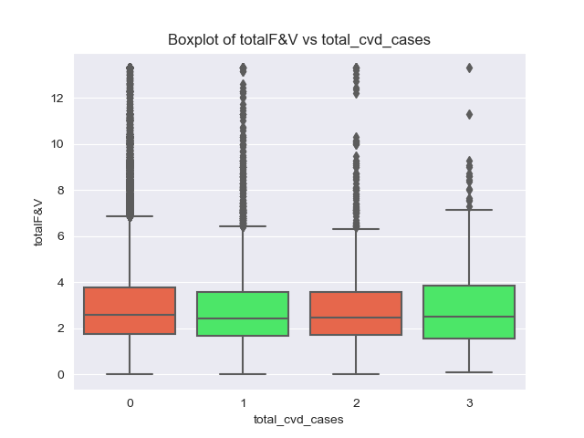
FINDINGS AND RESULTS
Total F&V:
Refers to the total daily consumption of fruits and vegetables
CVD:
-Heart Attack or MI
-Angina or CHD
-Stroke
Total CVD Cases represents the total of all cardiovascular diseases that each individual has reported having or had in the past.

Slide 5
FINDINGS AND RESULTS
RESEARCH QUESTION 2
How does socioeconomic status, emphasizing racial and ethnic backgrounds, influence healthcare access and overall health outcomes?
*Towne Jr., S. D. (2017): Socioeconomic, Geospatial, and Geopolitical Disparities in Access to Health Care in the US 2011–2015
Technique: multivariate logistic regression Analysis
found significant association (p<0.01) between race/ethnicity, income, sex to one’s likelihood of forgoing Medical Care due to cost.
My Findings :
Technique: Multivariate logistical Regression ;
Found significant associations( p < 0.05) btw race/ethnicity, education, income and sex and likelihood of forgoing medical care in the United States.

Slide 6
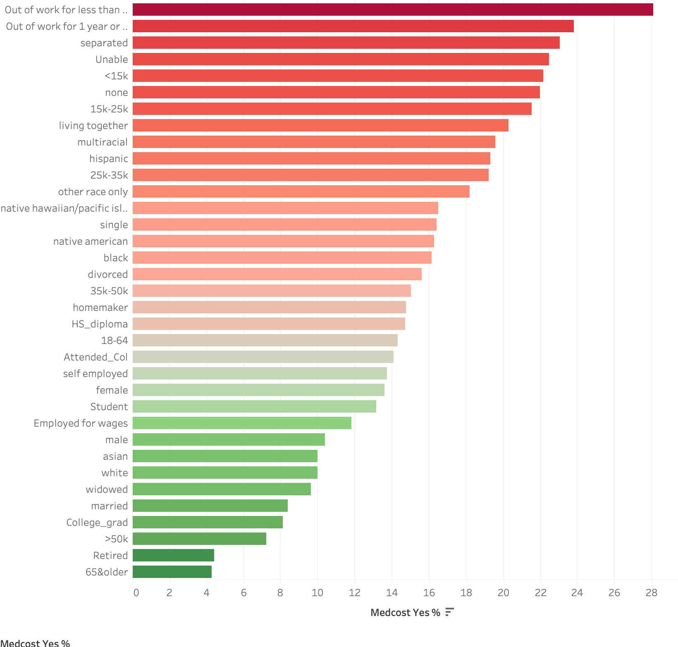
Distribution of Percentage Forgone Medical Care Based on Socio-Economic Subcategories
INSIGHTS FROM 2019 BRFSS ANALYSIS
~24% of Those who were unemployed for under a year
Opted out on medical care because of cost.
Only ~4% of those 65 years and older as well as those who are retired report opting out of Medical care because of cost
Minorities (Black and Hispanic) show much higher rates of Forgone Medical Care compared to White individuals.
Higher Educated individuals (college graduates) report lower rates of forgone Medical Care

Slide 7
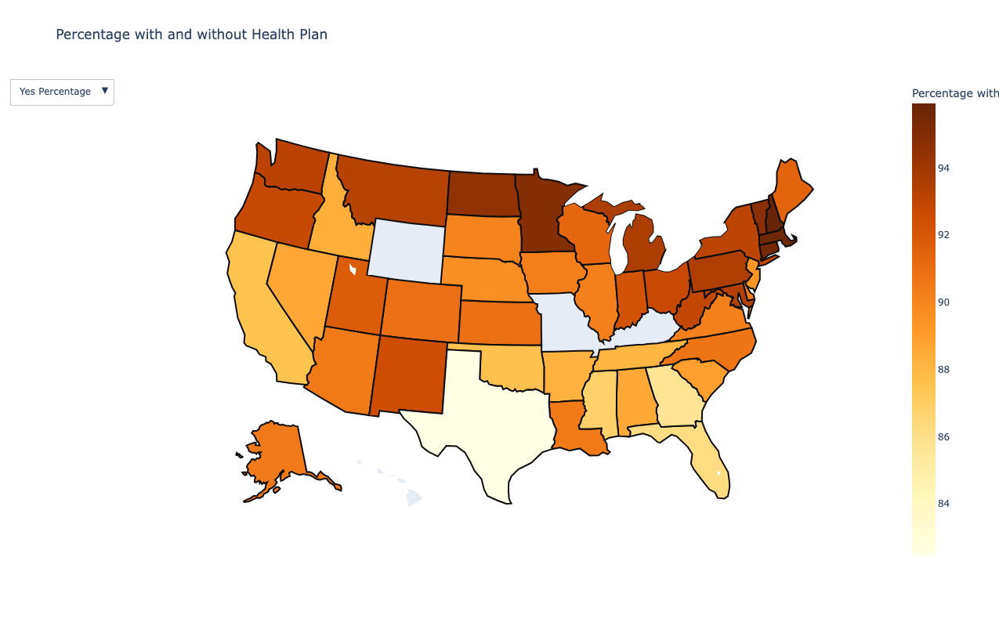
**Percentage of individuals in each state with some form of Healthplan**
North Dakota
Minnesota
Texas

Slide 8
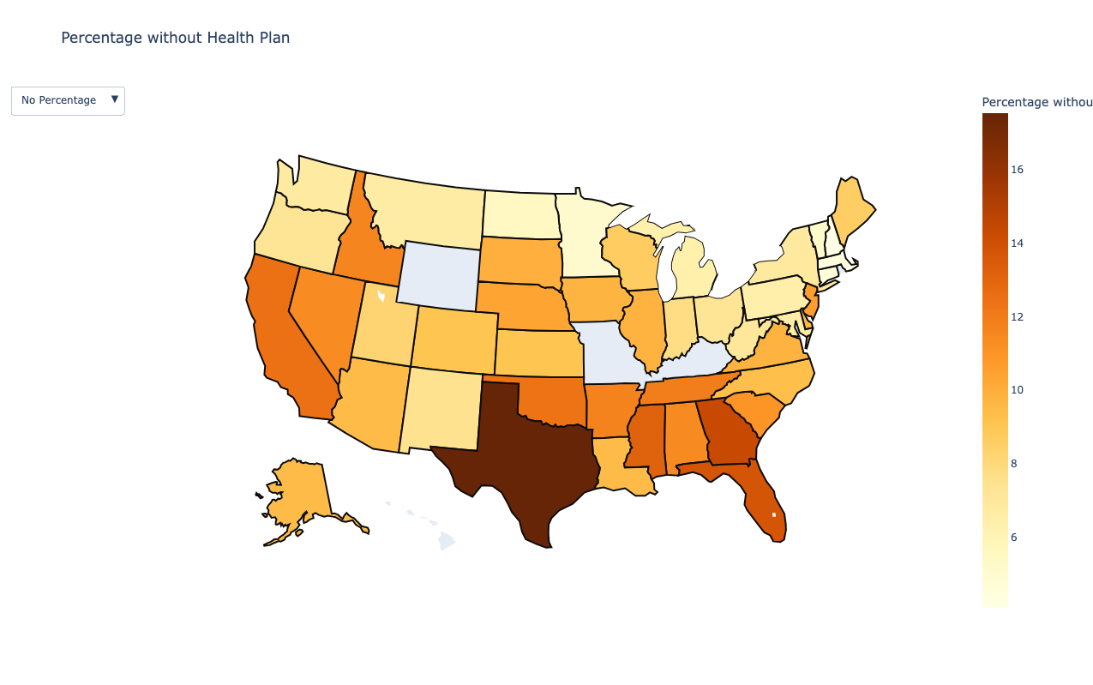
**Percentage of individuals in each states without a form of Healthplan **
Texas
Probably because of its high population 28 million people

Slide 9
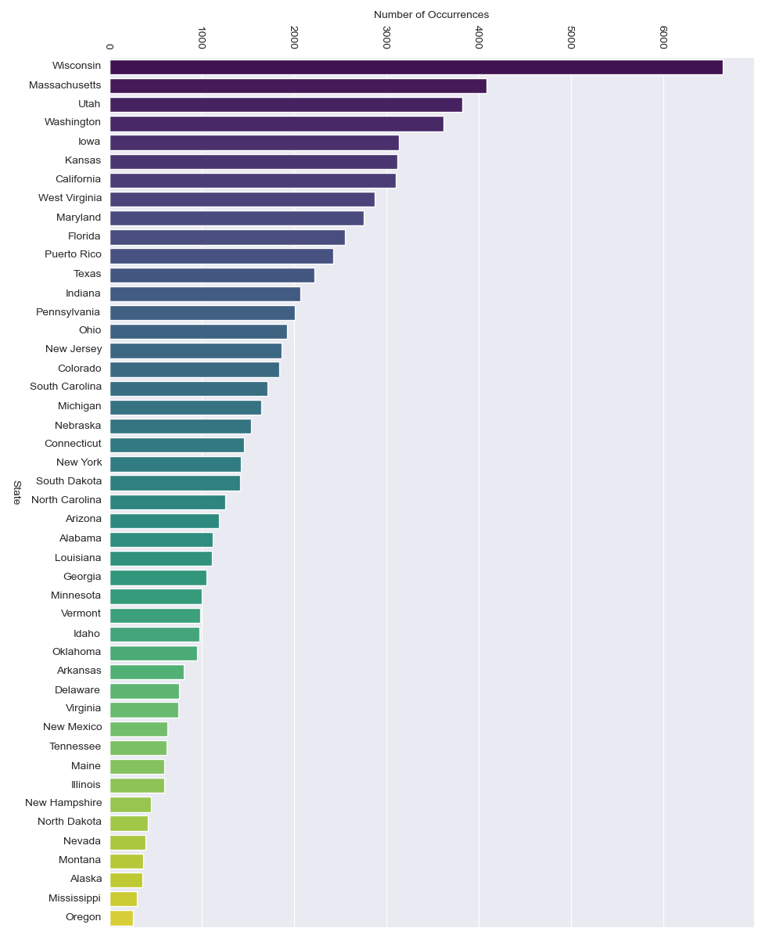
Number of Individuals with Healthplan in USA by State 2019 BRFSS Data

Slide 10
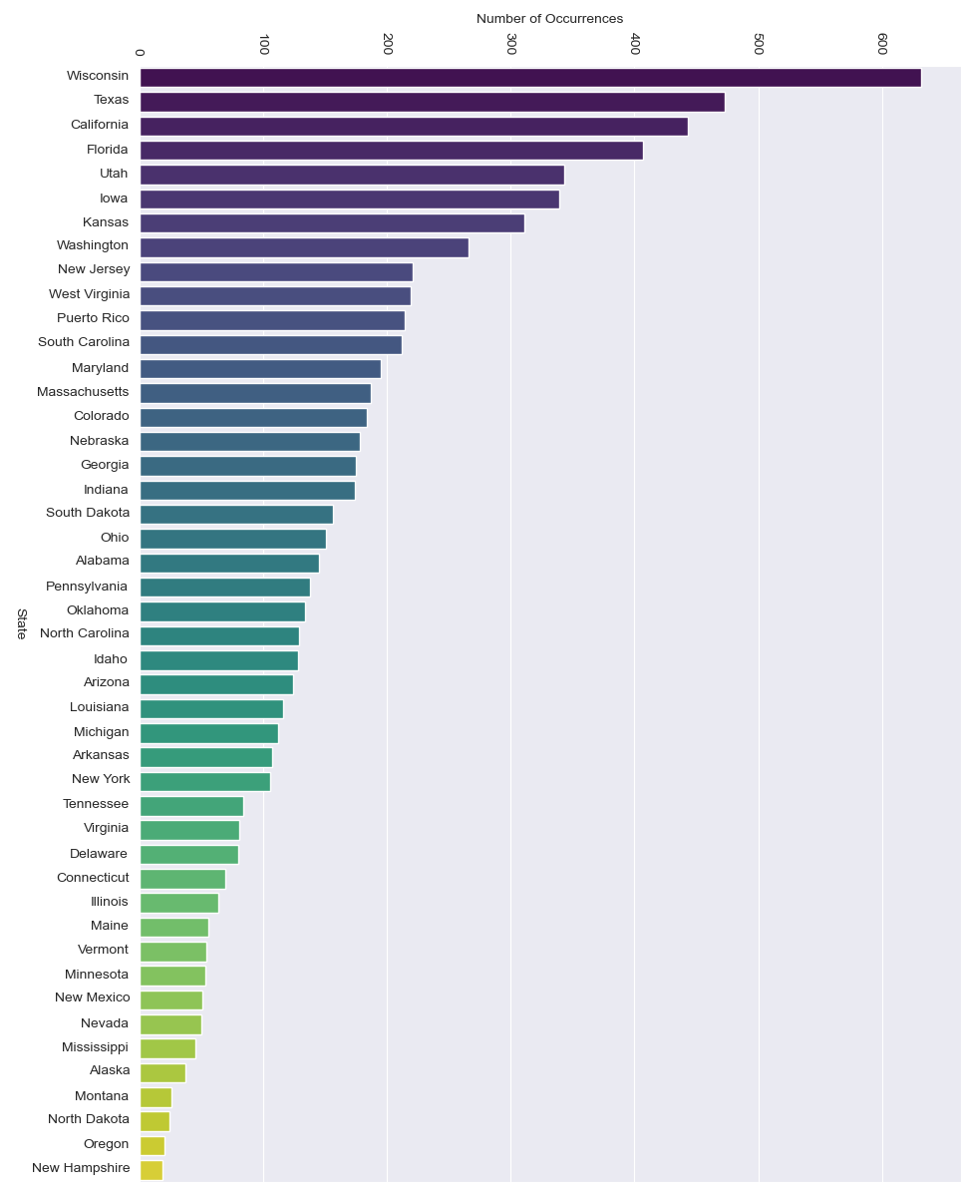
Number of Individuals without Healthplan in USA by State 2019 BRFSS Data

Slide 11
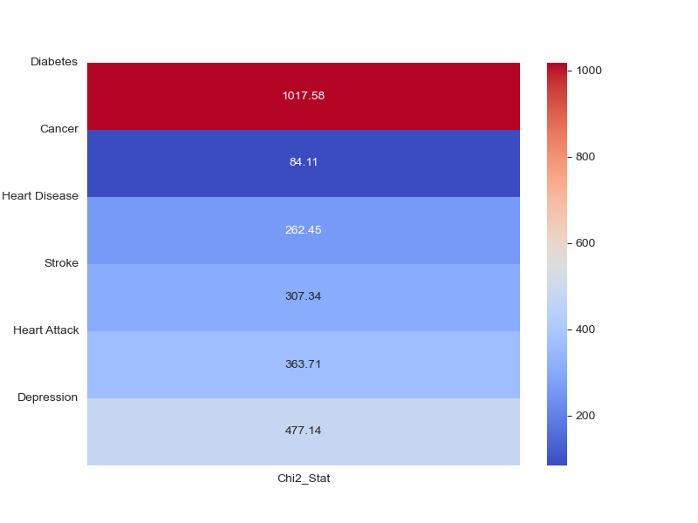
FINDINGS AND RESULTS
RESEARCH QUESTION 3
How does regular physical exercise influence tangible health outcomes, such as the risk of developing cancer, and mental health outcomes, including the likelihood of being diagnosed with depression?
Findings of research:
Pedersen, B. K., & Saltin, B. (2015).
Conducted analysis of Systematic Reviews, meta-analysis and randomized control trials.
“In many instances, exercise therapy is on par with, if not superior to, medical treatments in efficacy.”
Chi Squared Test of Association between Exercise and Chronic Diseases:
Very strong association between regular exercise and Chronic Diseases.
Highly significant
Exercise Vs Chronic Diseases

Slide 12
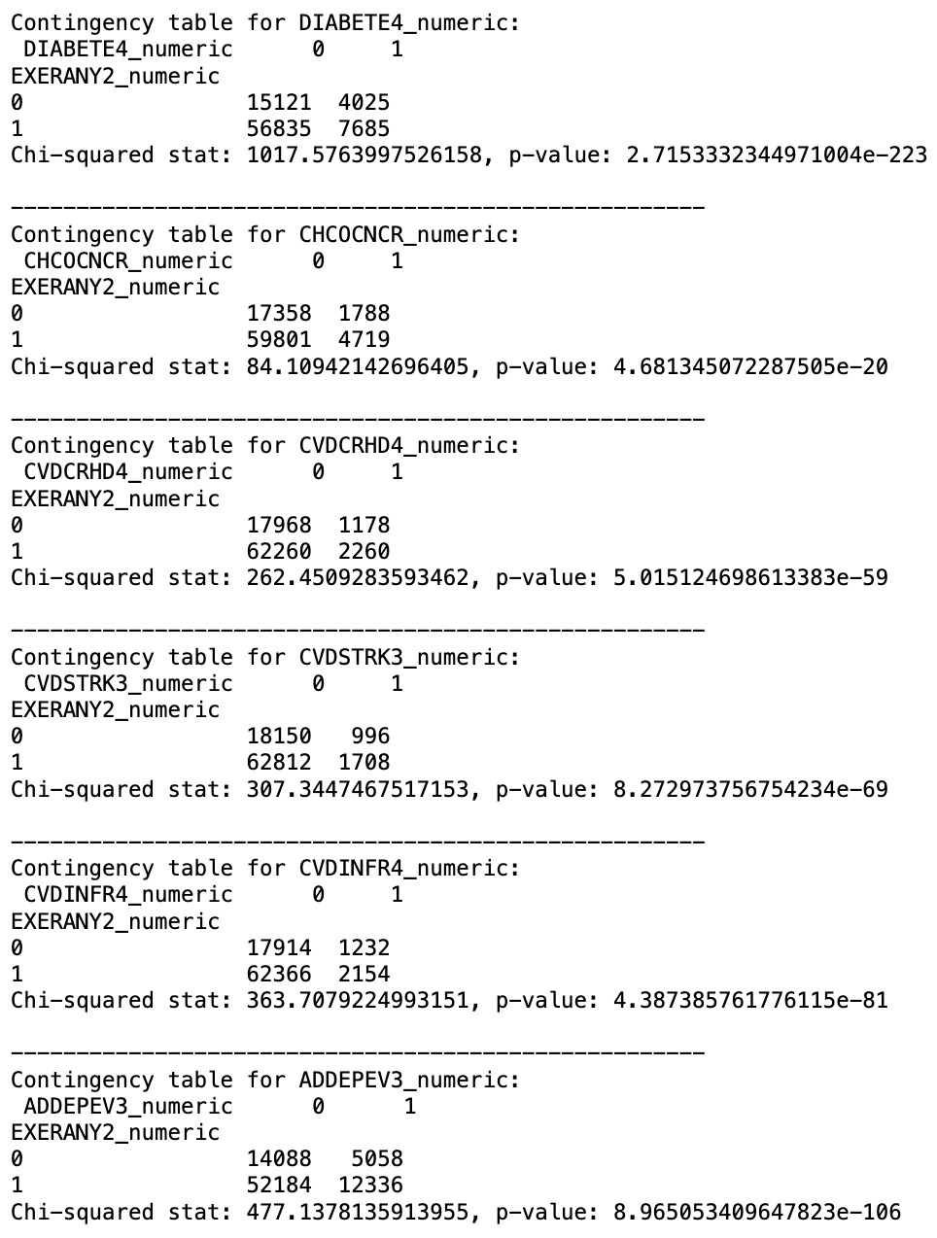
FINDINGS AND RESULTS
Contingency Table:
Helps Us to see the direction of Association Between Exercise and Each Chronic Disease
There is a clear strong Inverse Association with Exercise and Chronic Diseases.

Slide 13
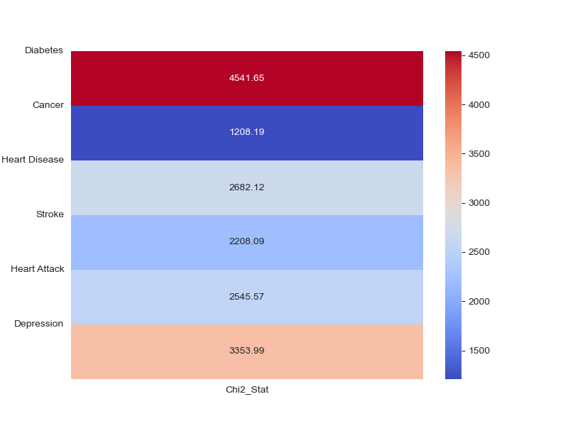
FINDINGS AND RESULTS
RESEARCH QUESTION 4
Is there a correlation between Chronic conditions and individuals self-assessed health status?
Findings of research:
Barreto and Figueiredo (2009).
Conducted Telephone based surveillance of risk Survey Analysis
(Showed an association between Chronic diseases and self-perceived health)
Chi Squared Test of Association between Self-Perceived Health and Chronic Diseases:
**The Chi-Squared Test is a non-parametric test for comparing two categorical variables in a large dataset to see if any association exists but does not imply any causation.**
Self-Perceived Health Vs Chronic Diseases

Slide 14
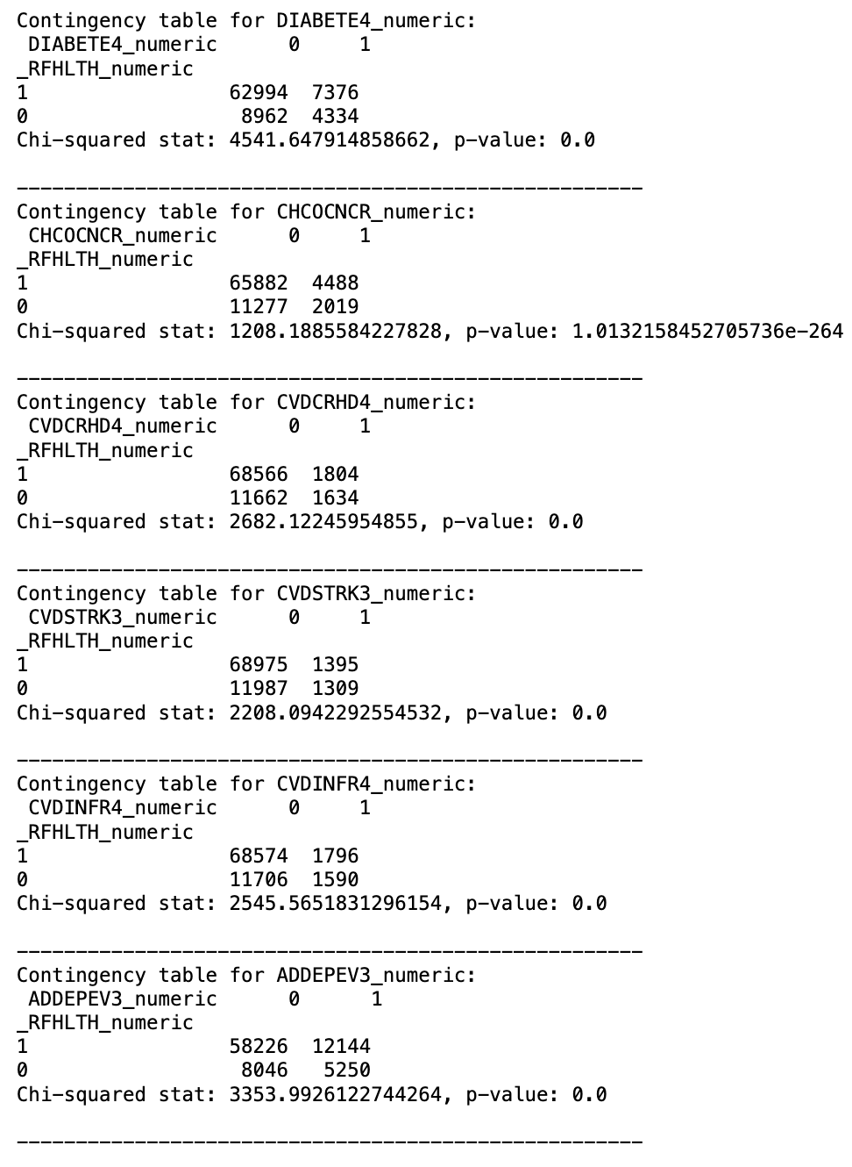
FINDINGS AND RESULTS
Contingency Table:
Helps Us to see the direction of Association Between Self-Perceived Health and Each Chronic Disease
There is a clear strong Inverse Association with Good Self-Perceived Health and Chronic Diseases.

Slide 15
FINDINGS AND RESULTS
RESEARCH QUESTION 5
Can perceived health be accurately predicted using dietary habits, socioeconomic indicators, lifestyle choices, and individual metrics?
Mbogori, T., & Arthur, T. M. (2019). Perception of Body Weight Status Is Associated with the Health and Food Intake Behaviors of Adolescents in the United States
**cross-sectional research**
(analysis of data from a population from a single timepoint)
Finding:
Adolescents who believed their weight was "just right" were more likely to describe their health status as either "very good" or "excellent."
Those perceiving their weight as "just right" consumed fruits and vegetables more frequently than their peers who saw themselves as either "underweight" or "overweight.”
Interplay between perception, health status, and dietary habits exists.
Having this knowledge, we decided to build Models to Predict Self- Perceived Health

Slide 16
BINARY CLASSIFICATION MODELS USING (_RFHLTH)
 | Effectiveness |  | Efficiency
MODEL | Recall (Fair/Poor Health) | Overall Accuracy | Training Time
Base Decision Tree | 54% | 87% | 106.8 seconds
Selected Features Decision Tree | 55% | 87% | 33.7 seconds
Base Logistic Regression | 79% Validation: 76% | 84% Validation: 85% | 172.2 seconds
Selected Features Logistic Regression | 76% | 83% | 7.4 seconds
Base Random Forrest | 51% | 88% | 1037.6 seconds
Selected Features Random Forrest | 58% | 88% | 913.2 seconds
Wilcoxon signed rank Test showed no statistically significant difference in mean cv accuracy scores

Slide 17
MULTI-CLASS CLASSIFICATION MODELS USING (GENHLTH)
 | Effectiveness |  | Efficiency
MODEL | Recall (Fair/Poor Health) | Overall Accuracy | Training Time
Base Decision Tree | 52% | 43% | 259.2 seconds
Selected Features Decision Tree | 51% | 41% | 83.8 seconds
Base Logistic Regression | 74% | 43% | 1143.112 seconds
Selected Features Logistic Regression | 75% | 39% | 115.5 seconds
Base Random Forrest | 50% | 47% | 1692.5 seconds
Selected Features Random Forrest | 52% | 44% | 1476.5 seconds
Wilcoxon signed rank Test showed no statistically significant difference in mean cv accuracy scores

Slide 18
Limitations: Self-Reported Data: Self-reporting Bias Non-Response Bias: Potential bias from Non-Responses Telephone Survey Limitations: Population exclusions may occur Sampling Errors: low response rates underrepresentation.

Slide 19
CONCLUSION
We were able to tackle all Research questions
Build a Model that predicts Self-Perceived Health with an Accuracy of 84% and a recall for fair or poor self perceived health of 79%
HOW WE CAN USE THIS INFORMATION :
Inform policies to increase access to Healthcare
Use the Classification Model to Intervene Early in patient care
Use the Classification Model to provide a form of Holistic treatment that also encourages those with good or perceived health

Slide 20
THANK YOU !

